Slide 1


April 1, 2014
Enterprise Design Patterns for the Pragmatic Programmer
hugeinc.com
info@hugeinc.com
45 Main St. #220 Brooklyn, NY 11222
+1 718 625 4843

Slide 2
1. Why you are here (1 minute) 2. Examples (35 minutes) 3. Questions (2 minutes)

Slide 3
Enterprise.

Slide 4
We are all Enterprise Developers.
The software you write is for very big companies.
They have a lot of money.
They will not respect you unless you are Enterprise.
Therefore, you must be Enterprise.

Slide 5
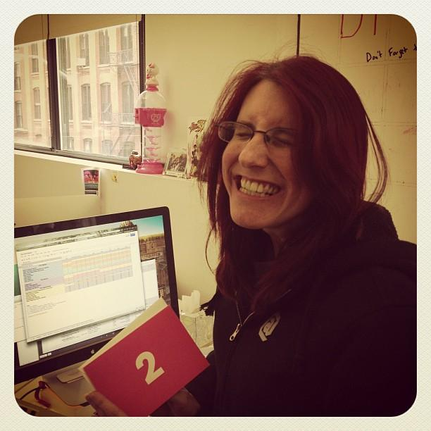
1. Very Big Companies.
“Before I used to code for myself. I lived off ramen noodles and passion. But when the XBox One came out I realized that my users need to be enterprise because I need to have a well seasoned MMORPG character when the game first comes out, not two years after when the price goes down.”
Kate F,
after her first Enterprise delivery.
Notes:
Kate has an XBox 1. I don’t think she plays MMORPGs.

Slide 6
2. Very Big Money.
“Back before I Enterprise, I always took a neutral stance. But I needed design patterns to break my pattern of being neutral. I needed to be more fly weight. Use more facades. Gang of four. After going Enterprise, my voice got deeper and I was able to grow more facial hair.”
Stefan,
After taking an offer from Huge.
Notes:
Hope Stefan is there for this slide.

Slide 7
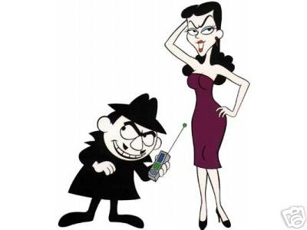
3. You have no choice.
“Remember: You don’t choose Enterprise. Enterprise choose you.”
John and Gela,
being all VP.
Notes:
John and Gela are likely to be there. :) They’ll laugh.

Slide 8
So how can I Enterprise?!?! Hang on there, sizzlechest. That is why you’re here.

Slide 9
1. All your arguments should lead to one big “idea” or it’s not Enterprise.
Wow! Big Font means Big Idea!
Argument
Did it
happen?
Argument
Sisyphus analogy
Argument
Notes:
Unlike a story plot, dragging on the argument while doing a project can result in looking smarter. This chart only demonstrates the ideas we deliver, following by the falldown once it’s delivered and invoiced. The Sisyphus analogy is used to show the slow climb it takes to get there.

Slide 10

2. Still be happy if it doesn’t happen.
He’s why:
“Through rigid documentation and apparent professionalism, one can often times bill millions of dollars without a single line of code written. Why? Because it’s enterprise.”
- Sales Jerk, RazorFish

Slide 11

“But my ideas are far too complicated to distill into a simple sentence. So I put them in thousands of pages of signed off documentation that show the edge cases of the Enterprise to ensure the facade of quality while looking really really smart.”
Some guy we promoted.

Slide 12
IZ READY 4 ENTURPRYZE LOLZ

Slide 13
Please stop. That makes you look 13.
Notes:
Enterprise developers eat, breathe, and shit professionalism. Look over 30, even if you’re not. And always use a professional font, like comic sans.

Slide 14

“Nobody challenges an Ira Glass quote.”
– Mark Twain

Slide 15
Eventually, your client will ask to see code so you have to show something.
Notes:
Check the audience. Make sure they are paying attention.

Slide 16

Time to code.
Notes:
Highlight here how we’ll show actual coding examples to the masses.

Slide 17
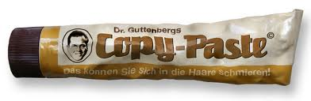
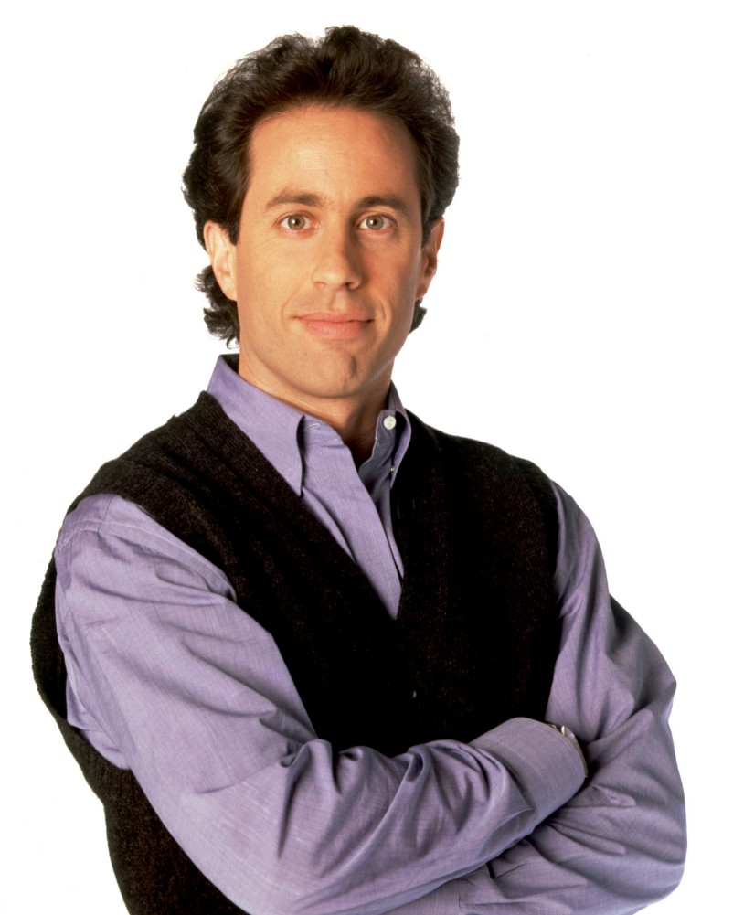
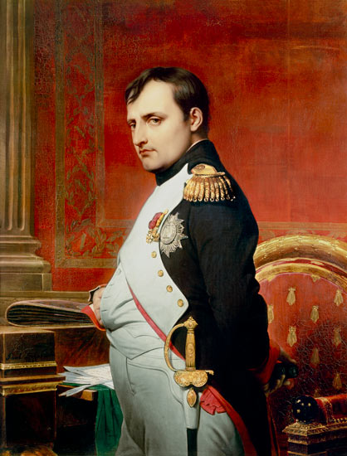
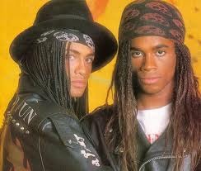

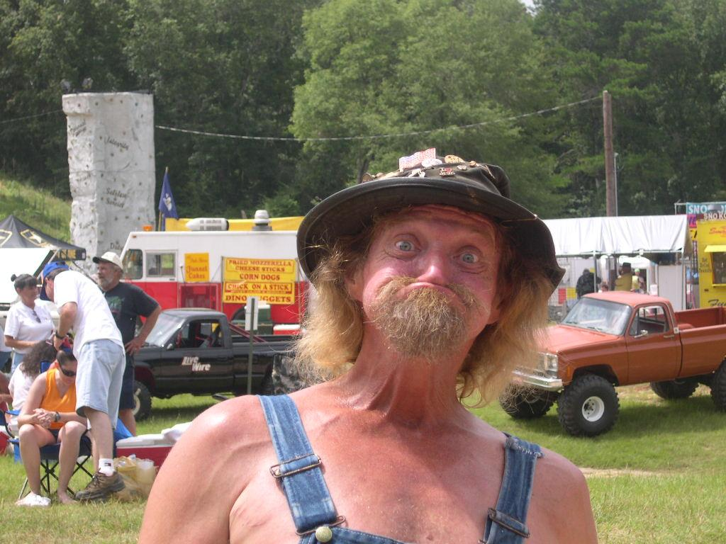
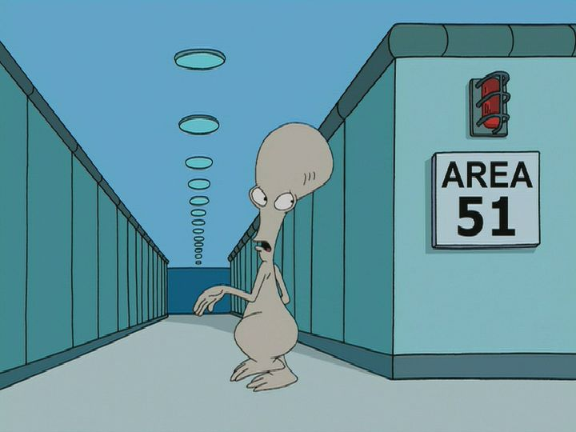
How can I code faster?

Slide 18
Use Enterprise Patterns written by Pragmatic Programmers
Notes:
Don’t drag on this, the next slides are all the patterns we found.

Slide 19
Pattern 1: The Seinfeld Pattern
Good luck with ALL THAT.
Notes:
You’re working hard on a problem. It’s late. Client wants it ASAP. You can code fast.
Deadline met. But you coded at 2AM.
All things at 2AM involve bad decisions. You get it done without thinking and say…
“Good luck with all that..”

Slide 20
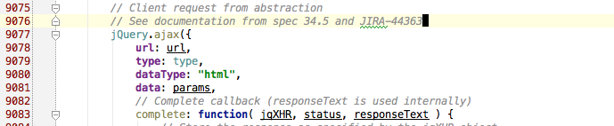
Code example
Notes:
Documentation reference
Code is over 9000 lines long.

Slide 21
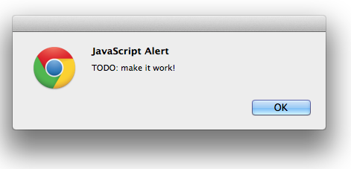
I code front end.
Enterprise schmenterprise.
Notes:
Mention how the last example was from the jquery code
quickly go over the next few slides.

Slide 22
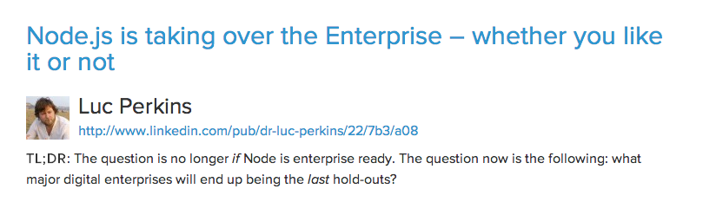
whatever.
Notes:
quick slide - just read title

Slide 23
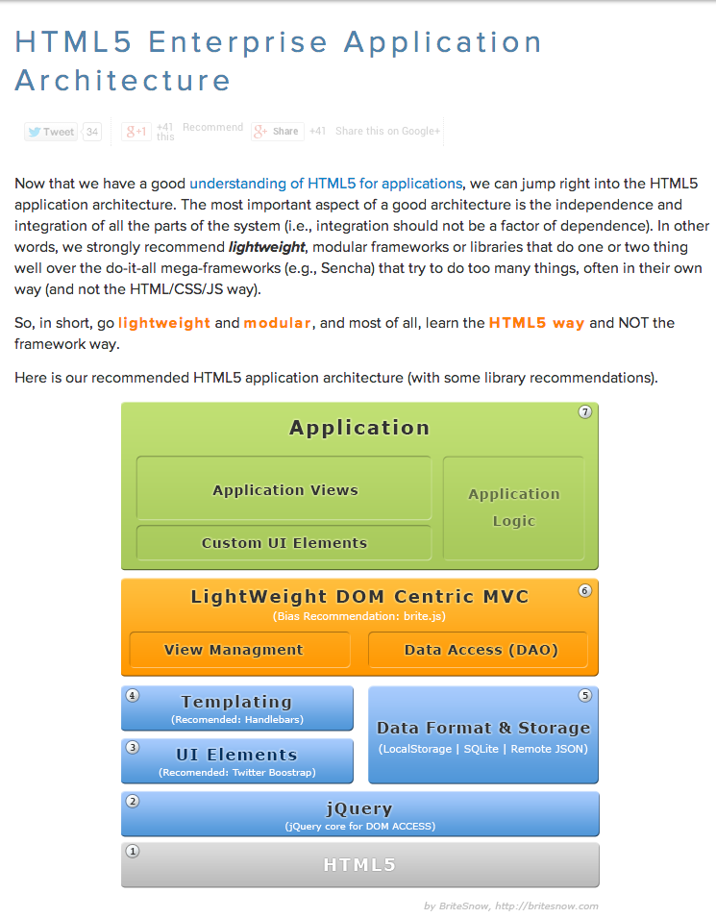
whatever.
Notes:
quick slide - just read title

Slide 24
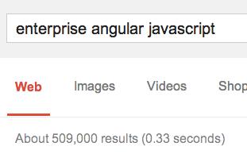
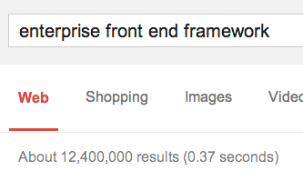
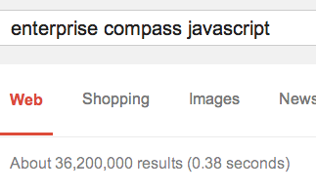
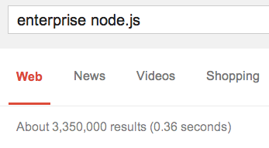
and… whatever.
Notes:
read number of results for each one

Slide 25
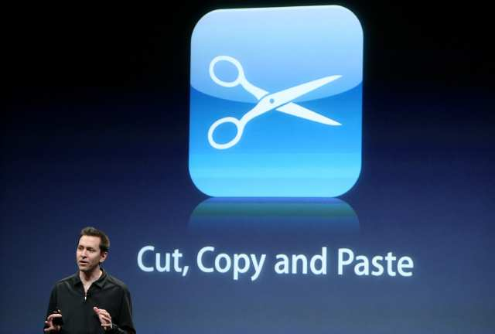
Pattern 2: The Arts and Craft Pattern
Notes:
Our favorite pattern
Talk about how FE/BE whatever ALWAYS does this
Ctrl c ctrl v design pattern is unique in that literally every programmer has used it at some point in their career, if not at some point this week. The use case for the ctrl c ctrl v pattern is when you need to do something similar to what you’ve already done, but you are too lazy to refactor your code. Simply copy paste the code and change some variable names.
Benefits of Ctrl C Ctrl V Pattern:
You are lazy
Easy to test (ctrl c ctrl v the relevant tests)
Straightforward
Drawbacks of Ctrl C Ctrl V
Long files
Sometimes hard to come up with good variable names

Slide 26
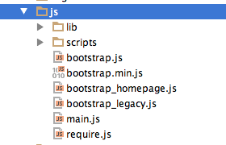
Code example
Notes:
Copying an entire class to prevent strange behavior in another part of the code. Often times happens when porting legacy pages over to fit inside.
Copying an entire class to prevent strange behavior in another part of the code. Often times happens when porting legacy pages over to fit inside.
Benefits
Straightforward
Easy to test (simply apply ctrl c ctrl v to the relevant test)
Good for lazy developers
Drawbacks
Long files
Can be hard to come up with good variable or function names

Slide 27
Pattern 3: The Onion Pattern
Notes:
Onion Design Pattern
You design with complexity in mind. You just got done reading a fun blog post about dependency injection, composition favoring inheritance, singletons, facades, and want to inherit the latest untested MVC controller.
You find a way to use all of them, without realizing you’re merely asking a user to login. In the end you give the client something that looks simple from the onset but once you debug it a new layer appears. Subsequent layers are revealed. After many layers of digging, they never end and you watch them cry.
Benefits
Sophisticated and modern
Makes for impressive documentation
You can send long winded emails to the team about how bleeding edge you are
Omnigraffle will love you
Clients love it!

Slide 28
Code example
Open onion example
Notes:
In the end you give the client something that looks simple from the onset but once you debug it a new layer appears. Subsequent layers are revealed. After many layers of digging, they never end and you watch them cry.
Benefits
Sophisticated and modern
Makes for impressive documentation
You can send long winded emails to the team about how bleeding edge you are
Omnigraffle will love you
Clients love it!
Drawbacks
Edge case bugs

Slide 29
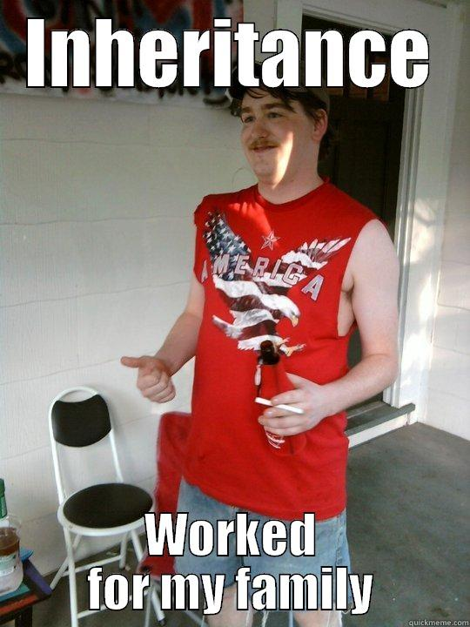
Pattern 4: The Redneck Pattern
Notes:
Redneck Design Pattern
Inheritance over injection
OO is based on inheritance - what could go wrong?
You’re using a utility class to inherit features instead of injecting the object into the class
Drawbacks
Inbreeding can be bad

Slide 30
Code example - AbstractParser
public abstract class AbstractParser {
public Integer getLastDigit(String notADigit) {
if (StringUtils.isEmpty(notADigit)) {
throw new IllegalArgumentException(
"empty string " + notADigit);
}
Pattern p = Pattern.compile("[0-9]+$");
Matcher m = p.matcher(notADigit);
final String result;
if(m.find()) {
result = m.group();
} else {
throw new IllegalArgumentException(
"No digits found " + notADigit);
}
return Integer.parseInt(result);
}
}
Notes:
abstract class takes one digit from the last place on the line and throws exception if no such digit exists

Slide 31
Code example - BankAccountService
public class BankAccountService extends AbstractParser {
private int accountBalance;
public BankAccountService(String balanceString) {
this.accountBalance = getLastDigit(balanceString);
}
public static void main(String[] args) {
BankAccountService bankAccountService =
new BankAccountService("$500");
System.out.println(
bankAccountService.getAccountBalance());
}
public int getAccountBalance() {
return accountBalance;
}
}
Notes:
wtf why inherit this as part of the account service?
will you ever use AbstractParser as a method signature?

Slide 32

Pattern 5: The Interface Inception Pattern
Notes:
Interface Inception is founded on one principle: if abstraction is good, then more abstraction is better.
You think there’s a chance that another component might one day extend your parser? Put an interface on it. You have a function, but it only returns an integer? What if you want to also return an array one day in the future? Put two interfaces on it. You connecting to three databases? Make 4 interfaces in case one dies.
Benefits of Interface Inception
Your code is ready to be extended, no matter what the feature may be
Job security

Slide 33
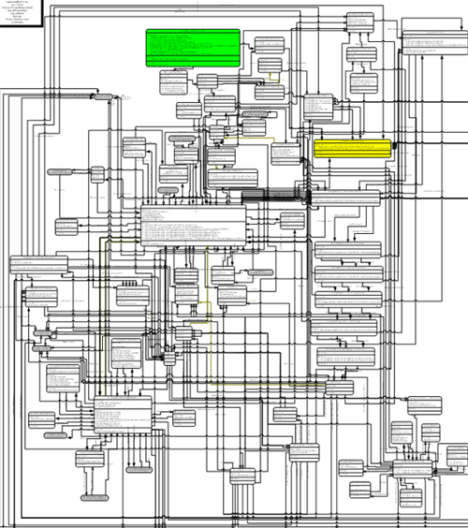
UML example
Notes:
Interface Inception is founded on one principle: if abstraction is good, then more abstraction is better.
You think there’s a chance that another component might one day extend your parser? Put an interface on it. You have a function, but it only returns an integer? What if you want to also return an array one day in the future? Put two interfaces on it. You connecting to three databases? Make 4 interfaces in case one dies.
Benefits of Interface Inception
Your code is ready to be extended, no matter what the feature may be
Job security

Slide 34
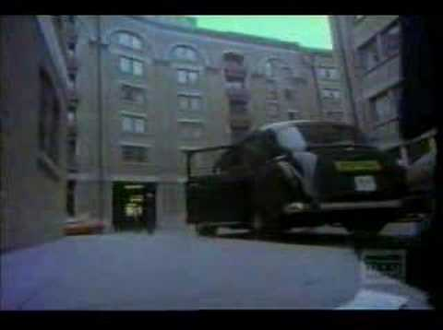
Pattern 6: The Milli Vanilli Pattern
Notes:
Talk about history of milli vanilli. go to point 1m33s and play 10 seconds

Slide 35
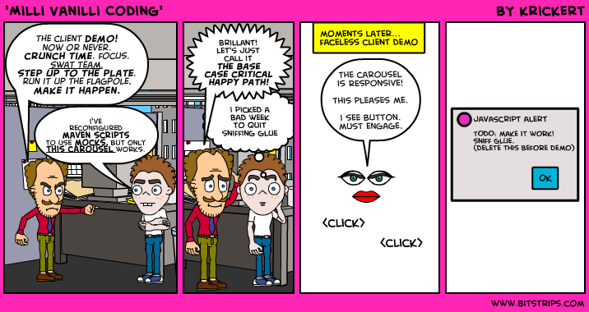
Comic example
Notes:
read comic and quick discussion

Slide 36
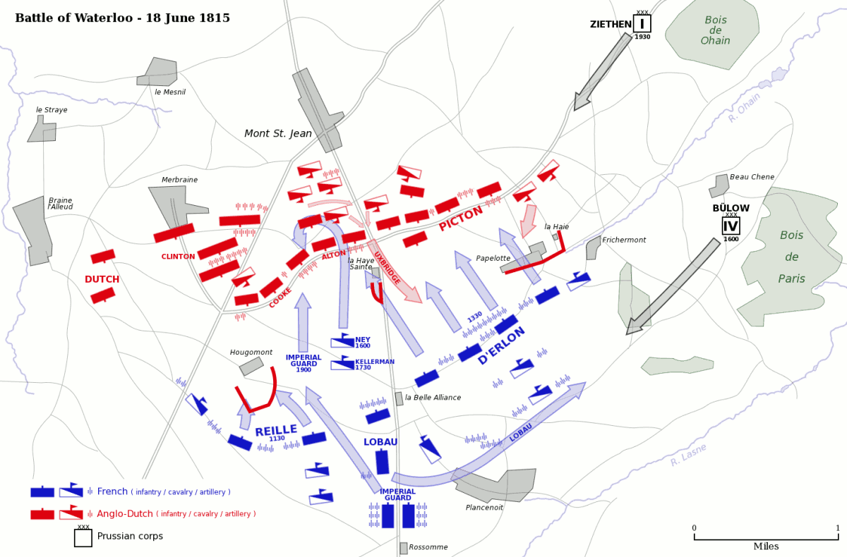
Pattern 7: The Waterloo Pattern
Notes:
What is it?
It’s late summer and day 1 on the project. You look at the scope. There’s one milestone in 6 months and you have to deliver the whole project. You try to tell everyone that you really should have milestones in between but you’re asked to “make it happen.” You’re ambitious. You take the challenge.
The project is cold. You have to march long and hard. You go further into the winter despite knowing the challenges. Your ambition brings you to the final invasion of Waterloo. It’s cold. Your soldiers are starving. You die.
How do I identify it?
Follow your heart and always make a timeline. Don’t agree to deadlines without the scope defined. It’s OK to give high level estimates - even necessary at times. But estimates are not deadlines. Don’t sign onto things you cannot do.
How do I fight it?
You always hear “work smart, not hard” and it’s hard to follow. If you are given scope you cannot finish, tell your manager. If your manager doesn’t listen, tell your director. If the director doesn’t listen, tell your VP. If the VP doesn’t listen, leave the project or get out of there.

Slide 37
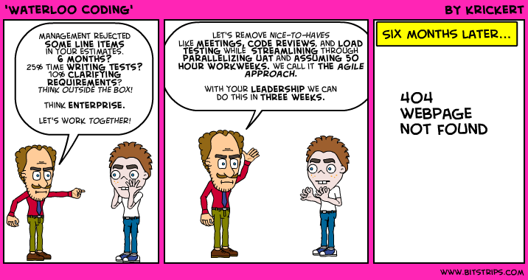
Comic example
Notes:
What is it?
It’s late summer and day 1 on the project. You look at the scope. There’s one milestone in 6 months and you have to deliver the whole project. You try to tell everyone that you really should have milestones in between but you’re asked to “make it happen.” You’re ambitious. You take the challenge.
The project is cold. You have to march long and hard. You go further into the winter despite knowing the challenges. Your ambition brings you to the final invasion of Waterloo. It’s cold. Your soldiers are starving. You die.
How do I identify it?
Follow your heart and always make a timeline. Don’t agree to deadlines without the scope defined. It’s OK to give high level estimates - even necessary at times. But estimates are not deadlines. Don’t sign onto things you cannot do.
How do I fight it?
You always hear “work smart, not hard” and it’s hard to follow. If you are given scope you cannot finish, tell your manager. If your manager doesn’t listen, tell your director. If the director doesn’t listen, tell your VP. If the VP doesn’t listen, leave the project or get out of there.

Slide 38
TODO: make a single word slide.

Slide 39
Directors agree.

Slide 40

1. Enterprise is good!
Whilst rubbing hockey pucks on my armpits, I realized my leadership empowers me to copy/paste robust code as a starting point for my own scalable code. It allows you to do more in 2-3x the time, plus looks GREAT on your resume.
Now hiring A+ Node/ Mongo/ CQ/ Bootstrap Ninjas. Tell your friends!
Karl Stanton,
after a few home brews.
Notes:
Karl stanton drinks a lot of beer which is good! He also likes to promote huge jobs even though it degrades the quality of his twitter account overall according to Klout.

Slide 41
2. Enterprise is unicorn!
I, Isaiah, purveyor of nerd. I’m bicorn - a unicorn with 2 horns. I pierce you dead if you cancel your Tech talk. Mike Welles and Kristian will hide the body on command- so listen to them.
Unicorns use these patterns, and I snore them in my sleep. You can Unicorn Too!
Isaiah Belle,
purveyor of fine fancy cocktails / unicorn.
Notes:
I shouldn’t be mean to Isaiah because he’ll be paying my salary in a year or two - Katie
Isaiah is unicorn! - Kristian

Slide 42
Be Enterprise or you are a bazootiehead.

Slide 43
Questions?

Slide 44
April 1, 2014
Enterprise Design Patterns for the Pragmatic Programmer
Done.
hugeinc.com
info@hugeinc.com
45 Main St. #220 Brooklyn, NY 11222
+1 718 625 4843

